Slide 1
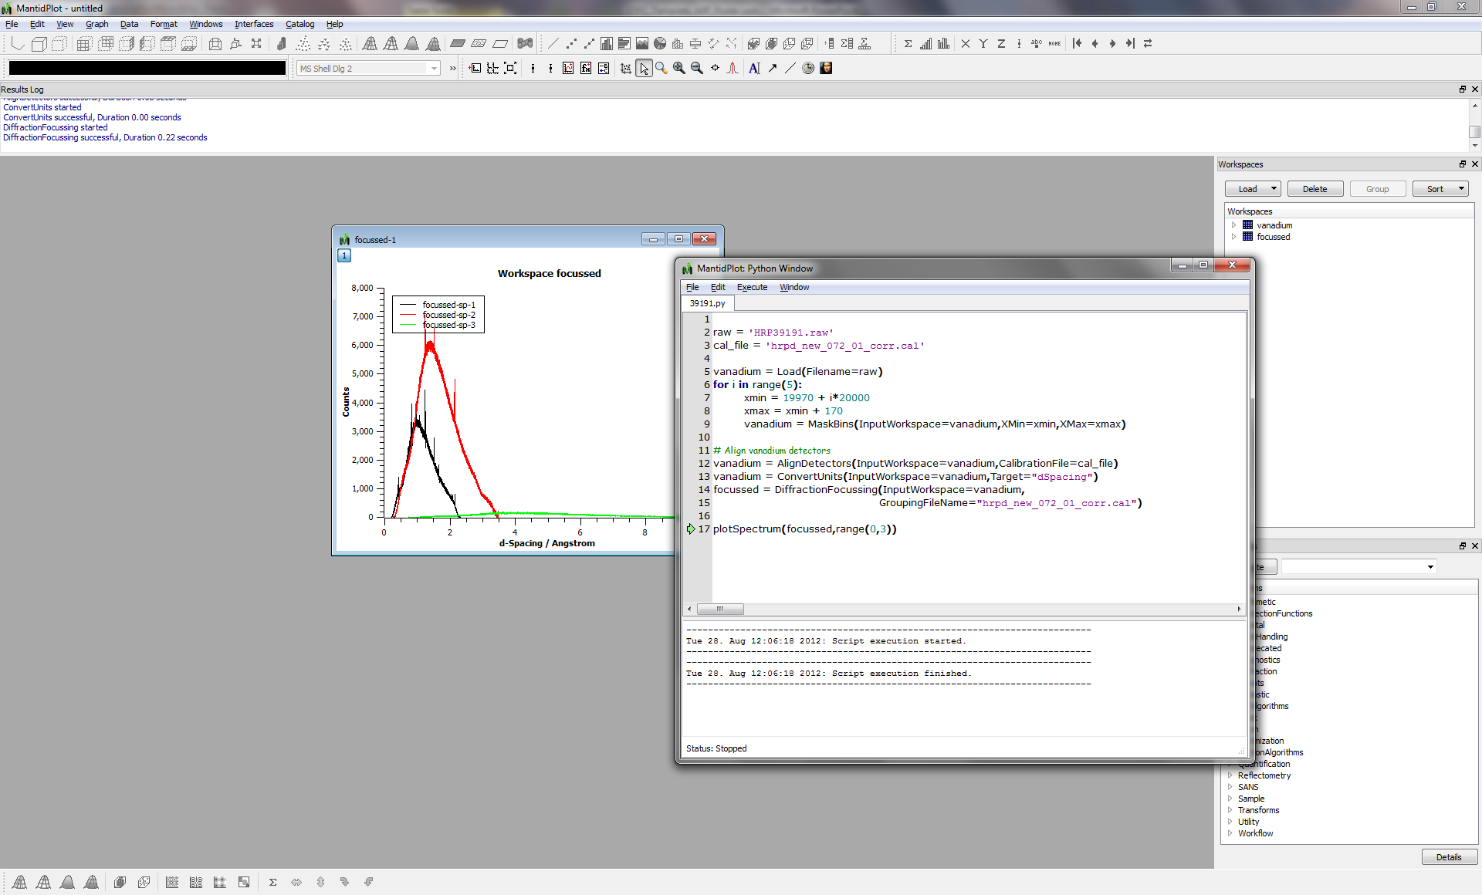
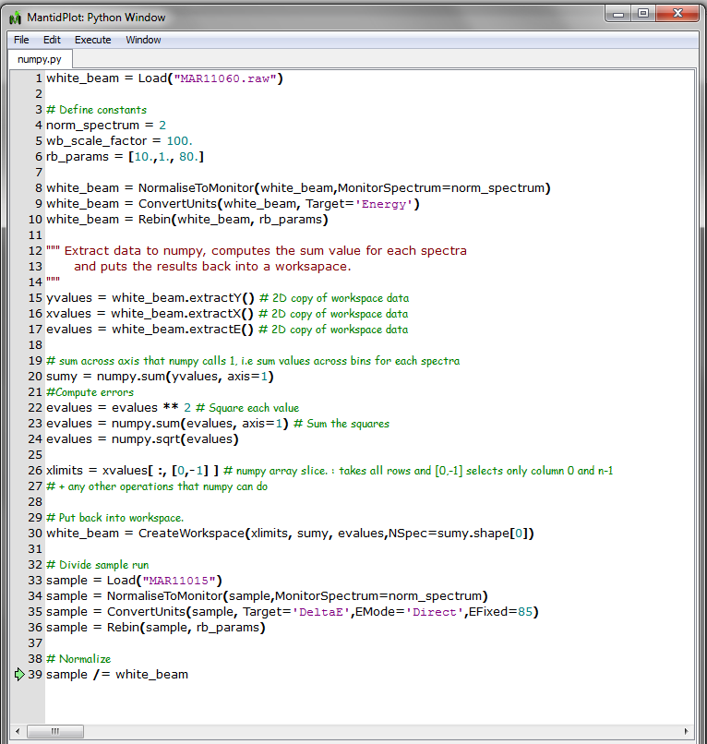
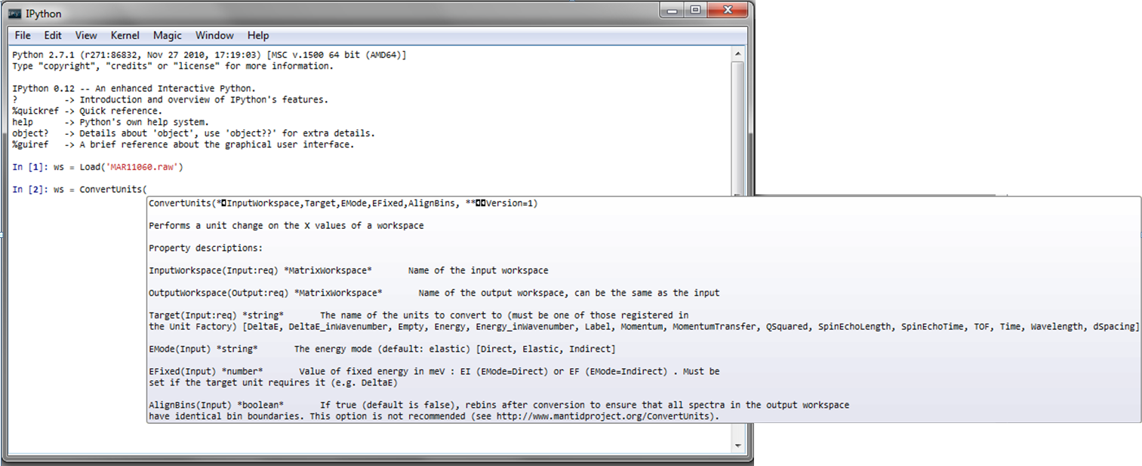


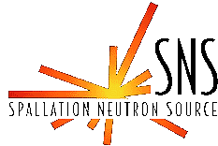
Deep Integration With Python -
The New Mantid API
Martyn Gigg
Tessella, 26 The Quadrant, Abingdon, Oxfordshire, OX14 3YS
Background Mantid version 1.x contained a Python API that provided users with the ability to automate their reduction tasks but the API was not the most intuitive to use. While Mantid was gaining ground in usage across ISIS & ORNL a consultation was started with existing users with the aim of improving the long-term usability of the interface. Mantid version 2.0 saw the introduction of a new Python interface that retains the abilities to let users write complex processing scripts that mix the Mantid API with any available Python package. Snapshot of reduction script inside embedded Python interpreter/editor within MantidPlot While the new API is simpler and more intuitive it also has a much improved backend interface to the Mantid C++ libraries. Examples of such improvements are: direct translation from Python types to C types without going via strings wrapping of Mantid arrays with NumPy at the C++ level to avoid excessive copying when accessing data converting C++ types to Python types using the Python C API, i.e. C++ map → Python dictionary Syntax We took the opportunity of this change to improve the usability of the syntax used in the new Python API. Both to make it more intuitive and centred around the data, and to remove unnecessary steps and commands. A comparison of the body of a python algorithm written in both APIs, highlighting the clearer and smaller code necessary for the same task. Managing the change Any change like this to existing software with an established user base need to be introduced carefully, ensuring the users can continue to use or update easily any existing scripts they already rely on. Therefore within Mantid we support both the old and new APIs, and can switch between them easily with a single command. To use the old API: from mantidsimple import * To access the new API: from mantid.simpleapi import * Furthermore we have provided a python program that can automatically migrate existing scripts from the old to the new API. python [MANTIDINSTALL]/scripts/migrate1to2.py your_file_here |  | NumPy The NumPy package provides a generic multi-dimensional array object along with a large number of pre-defined mathematical functions to act on these arrays. In addition to extensive functionality they are also much faster than Python lists when wishing to perform calculations on an entire dataset. In Mantid most users run a set of C++ algorithms to perform their reduction/analysis. Access to the “raw” data from each computation though is a must have. To provide this there are several solutions: Comparison of various methods for exposing C++ data to Python The clear winner from a user’s perspective is wrapping the existing C++ data with a NumPy façade. This allows users to manipulate the data as if it were a NumPy array but avoids the overhead of having to copy the data first. The expense is on the developer side and the difficulties will only need to be encountered once. In addition to this “wrapping” Mantid also provides a read-only wrapper around the data allowing only non-modifying operations and an extract method to perform a copy into a new multi-dimensional array. Mixing Mantid & NumPy functionality IPython The standard Mantid Python file & command line interpreter offer two complementary ways of executing Python code: edit & run all/part of file single line execution with immediate return The IPython package provides a rich interactive shell with features such as: tab completion history inline system commands that improve the overall workflow when working with Python interactively. In Mantid v2 we have included an option to launch an IPython console from within MantidPlot (full details at http://www.mantidproject.org/IPython_Console), which offers all of the usual IPython features but also embeds MantidPlot within the IPython environment allowing full control of Mantid. MantidPlot with an IPython shell showing an inline algorithm help
Access Method | Pros | Cons
Direct Access to C++ array | easy, fast | unfamiliar type in Python, little functionality
Copy data to Python list | familiar Python type | slow when creating & using
Wrap with NumPy array in C++ layer | fast, functional, familiar type | difficult to do generically, requires NumPy as dependency at C++ level
Old Python API | New Python API
file = “c:/Filename.nxs" calFile = “c:/CalFile.cal" tempWorkspace = "__tmp_SimplePowderDiffraction“ resultWorkspace = “wspace“ Load(file,tempWorkspace) tmpWs = mtd[tempWorkspace] AlignDetectors(tmpWs,tmpWs,calFile) DiffractionFocussing(tmpWs,resultWorkspace,calFile) wspace = mtd[resultWorkspace] mtd.sendLogMessage(“Result workspace="+str(wspace)) #need to delete the temp workspace names mtd.deleteWorkspace(tempWorkspace) | file = “c:/Filename.nxs" calFile = “c:/CalFile.cal" tmpWs = Load(file) tmpWs = AlignDetectors(tmpWs, calFile) wspace = DiffractionFocussing(tmpWs, calFile) mtd.sendLogMessage("Result workspace="+str(wspace)) #need to delete the temp workspace names DeleteWorkspace(tmpWs)

